Slide 1
Binary Numbers
NIRJAL MAHARJAN
BSc.CSIT ‘A’
022BSCIT024
2/16/2023

Slide 2
Contents
DECIMAL NUMBER SYSTEM 3
BINARY NUMBER SYSTEM 3-4
OCTAL NUMBER SYSTEM 5
HEXADECIMAL NUMBER SYSTEM 5
IMPORTANCE OF NUMBER SYSTEM 6
CONVERSION OF NUMBER SYSTEM 7-13
r’s COMPLEMENT & (r-1)’s COMPLEMENT 14-18

Slide 3
Decimal number system
This number system consists of 10 digits (0-9).
It is also called base 10 number system because its radix is 10.
Each digits has its value based on its position.
Digital number system are commonly used for daily life calculation.
For Example:
(1011)₁₀ , (2496)₁₀, (369)₁₀ etc. are decimal numbers.
Binary Number system
It is a number system that uses two digits (binary 1 & 0) to represent numbers. It is base 2 number system.
These two digits 1 & 0 represent different meanings: ON & OFF.
For Example:
(1011)₂, (111)₂, (11010110)₂ etc. are binary numbers.

Slide 4
Binary number system (continued..)
In any binary number, the rightmost digit is called least significant bit (LSB) and leftmost digit is called most significant bit (MSB).
1 | 1 | 0 | 1 | 0
MSB
LSB

Slide 5
octal Number system
It is a number system that uses 8 digits (0-7) to represent numbers. It is also called base 8 number system.
For Example:
(734)₈, (1011)₈, (24623)₈ etc. are the examples of octal numbers
hexadecimal Number system
It is a number system that uses 16 symbols i.e., 9 digits (0-9) and 6 alphabets to represent numbers.
It is also called base 16 number system.
For Example:
(A79F)₁₆, (1011)₁₆, (BCA)₁₆ etc. are the examples of hexadecimal numbers.

Slide 6
Importance of Number system
The number system is used in the computer system for better communication and representation.
The computers can only understand numbers; therefore, it converts every letter and word into numbers for better understanding and processing.

Slide 7
Conversion of number system
CONVERSION FROM BINARY TO DECIMAL (BASE 2 TO BASE 10)
Rules:
Multiplying each bit by corresponding power of 2 (starting from 0).
Sum each product term to get decimal equivalent number.
Example:
convert (110011)₂ to decimal.
Solution:
(110011)2 = 1*2⁵ +1*2⁴ + 0*2³ + 0*2² +1*2¹+ 1*2⁰
=32+16+0+0+2+1
= (51)₁₀

Slide 8
CONVERSION FROM BINARY TO OCTAL (BASE 2 TO BASE 8)
Rules:
Divide the given number into group of 3 bits from right to left . Insert ‘0’ if necessary to make each group 3 bits.
Substitute each group of three bits by octal equivalent from table.
Octal-Binary table
Example:
convert (10110101)₂ to octal.
Solution:
dividing the given binary number into group of 3 bits from right to left, we have
010 110 101
2 6 5
Hence, (10110101)₂= (265)₈
Octal | Binary
0 | 000
1 | 001
2 | 010
3 | 011
4 | 100
5 | 101
6 | 110
7 | 111

Slide 9
Hexadecimal-Binary table
CONVERSION FROM BINARY TO HEXADECIMAL (BASE 2 TO BASE 16)
hexadecimal | Binary
0 | 0000
1 | 0001
2 | 0010
3 | 0011
4 | 0100
5 | 0101
6 | 0110
7 | 0111
8 | 1000
9 | 1001
A | 1010
B | 1011
C | 1100
D | 1101
E | 1110
F | 1111
Rules:
Divide the given number into group of 4 bits from right to left . Insert ‘0’ if necessary to make each group 4 bits.
Substitute each group of four bits by hexadecimal equivalent from table.
Example:
convert (10101011101)₂ to octal.
Solution:
dividing the given binary number into group of 4 bits from right to left, we have
0101 0101 1101
Using table, 5 5 D
Hence, (10101011101)₂ = (55D)₁₆

Slide 10
Conversion from decimal to binary
Rules:
Divide the given number by 2 and note the remainder.
Repeatedly divide the quotient by 2 and note the remainder until quotient is 0.
Collect the remainders, from bottom to top.
Example: convert (51)₉ to binary
Remainder
Hence, (51)₉= (110011)₂
2 | 51 | 1
2 | 25 | 1
2 | 12 | 0
2 | 6 | 0
2 | 3 | 1
2 | 1 | 1
 | 0

Slide 11
Conversion of decimal to octal and hexadecimal:
Similarly for every conversion of decimal to other number system, we should divide the decimal number by the base(radix) of the desired number system (i.e. dividing by 8 for octal and 16 for hexadecimal conversion).

Slide 12
Conversion of Octal to binary
Rules:
Substitute each octal digit by equivalent 3 bits binary from table
Example:
7 4 1
Using table, 111 110 001
Hence, (741)₈ = (111110001)₂
Octal | Binary
0 | 000
1 | 001
2 | 010
3 | 011
4 | 100
5 | 101
6 | 110
7 | 111

Slide 13
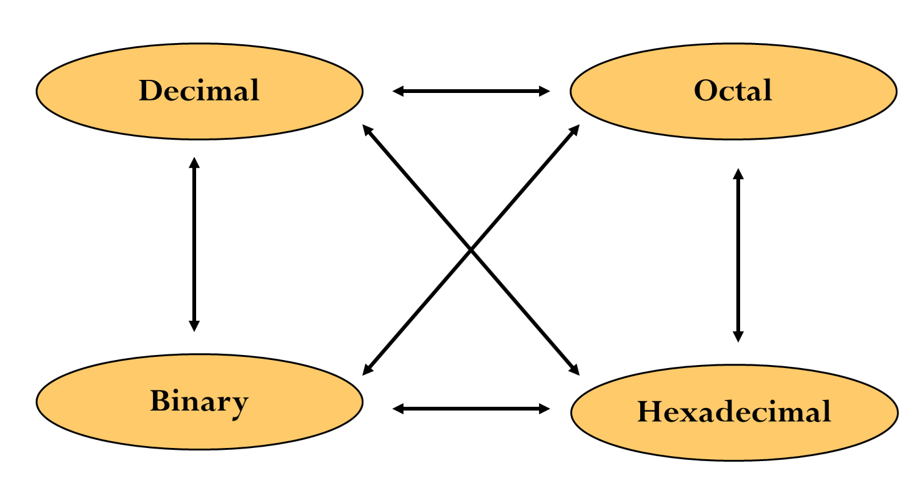
Conversion of hexadecimal to binary
hexadecimal | Binary
0 | 0000
1 | 0001
2 | 0010
3 | 0011
4 | 0100
5 | 0101
6 | 0110
7 | 0111
8 | 1000
9 | 1001
A | 1010
B | 1011
C | 1100
D | 1101
E | 1110
F | 1111
Rules:
Substitute each hexadecimal digit by equivalent 4 bits binary from table
Example: A 1 D
Using table, 1010 0001 1101
Hence, (A1D)₁₆ = (101000011101)₂

Slide 14
complement
(r-1)'s complement
The (r-1)'s complement of a number in any number system with base r can be found out by subtracting every single digit of a number by r-1.
For Example: In the binary number system, the base is 2. Hence, its (r-1)'s i.e., (2-1 =1)'s complement can be obtained by subtracting each bit from 1, i.e., 1's complement for 001 can also be calculated by subtracting 001 from 111 which will be (111-001) = (110)2.
Similarly, in the octal number system, the base is 8 so its 7's complement can be calculated by subtracting each bit by 7, i.e., 7's complement for 347 in octal number system can be calculated by subtracting 347 from 777 which will yield (777 – 347) = (430)8.
2. r's complement
The r's complement of a non-zero number in any number system with base r can be calculated by adding 1 to the LSB of its (r-1)'s complement.
For Example: In binary number system, 2's complement of 001 can be calculated by adding 1 to the LSB of its 1'complement (i.e., 110 + 1) = (111)2.
Similarly, in octal number system, 8's complement of 347 can be calculated by adding 1 to the LSB of its 7'complement (i.e., 430 + 1) = (431)8.

Slide 15
1’s Complement
_{11111 – 1111}
_{Solution:}
_{M - 11111}
_{N - 1111}
_{Making no. of bits equal,}
_{M - 11111}
_{N - 01111}
_{1’s complement of N:}
_{N’ - 10000}
_{Adding M and N’:}
₁₁₁₁₁
₊₁₀₀₀₀
₁₀₁₁₁₁
Since there is an end carry. So, we add it to the remaining result.
₀₁₁₁₁
₊₁
₁₀₀₀₀
Hence, The required difference is 10000.

Slide 16
2’s Complement
_{11111 – 1111}
_{Solution:}
_{M - 11111}
_{N - 1111}
_{Making no. of bits equal,}
_{M - 11111}
_{N - 01111}
2’s complement of N: (1’s complement + 1)
_{N’ - 10000 + 1 =10001}
_{Adding M and N’:}
₁₁₁₁₁
₊₁₀₀₀₁
₁₁₀₀₀₀
Since there is an overflow bit. So, we discard it.
Hence, The required difference is 10000.

Slide 17
9’s Complement
_{55555 – 5555}
_{Solution:}
_{M - 55555}
_{N - 5555}
_{Making no. of bits equal,}
_{M - 55555}
_{N - 05555}
9’s complement of N: (9’s complement + 1)
_{N’ - 94444+1 = 94445}
_{Adding M and N’:}
₅₅₅₅₅
₊₉₄₄₄₅
₁₅₀₀₀₀
Since there is an end carry. So, we discard it.
Hence, The required difference is 50000.

Slide 18
10’s Complement
_{55555 – 5555}
_{Solution:}
_{M - 55555}
_{N - 5555}
_{Making no. of bits equal,}
_{M - 55555}
_{N - 05555}
_{10’s complement of N:}
_{N’ - 94444}
_{Adding M and N’:}
₅₅₅₅₅
₊₉₄₄₄₄
₁₄₉₉₉₉
Since there is an end carry. So, we add it to the remaining result.
₄₉₉₉₉
₊₁
₅₀₀₀₀
Hence, The required difference is 50000.

Slide 19
THANK YOU
NIRJAL MAHARJAN
BSc.CSIT ‘A’
022BSCIT024@sxc.edu.np

